Slide 1
Effect of PhyloP scores on Random Forest performance
*phyloP scores are based on hg19 reference genome

Slide 2
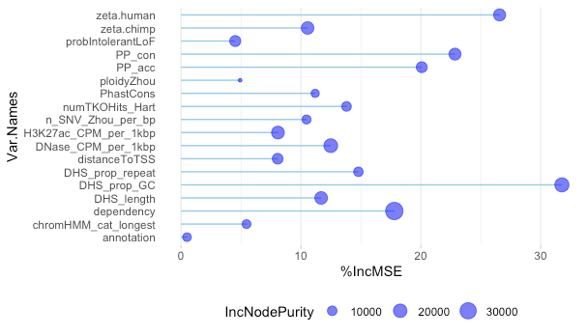
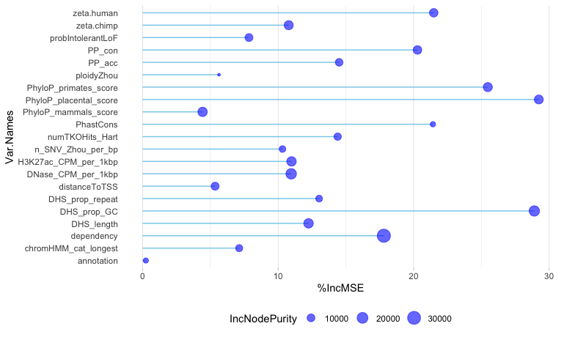
CERES Forest - wgCERES_score_nosig as the response vector
Excluding phyloP scores
Including phyloP scores
Notes:
Why would phyloP be a confounder in this case?
Conserved == functionally significant
Readout of function is doubling time (proliferation)
Is there an artifact in the placental scores that is causing that, since the decrease in IncNodePurity is largest here

Slide 3
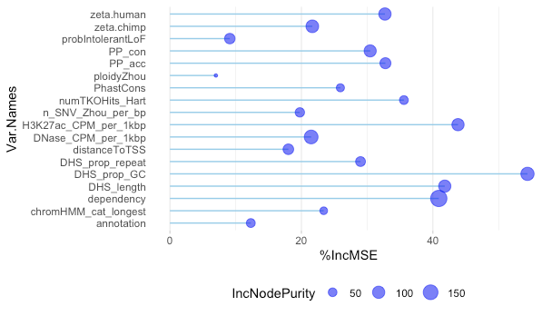
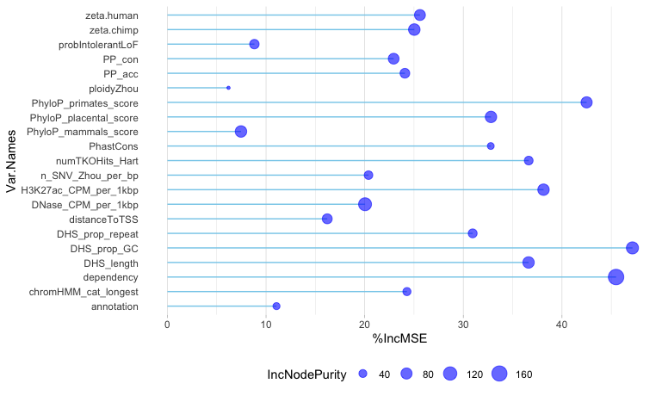
dhsWGsig Forest - dhs_0_1_wg (0,1: was DHS (all gRNAs grouped) significant across all DHSs?) as response vectors
Excluding phyloP scores
Including phyloP scores

Slide 4
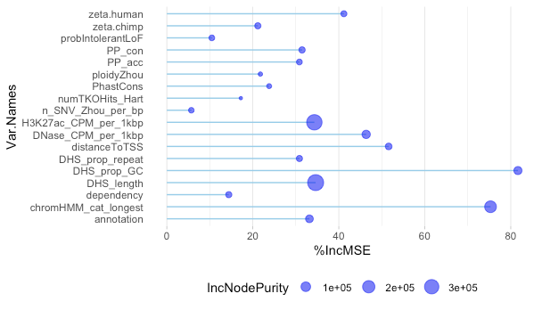
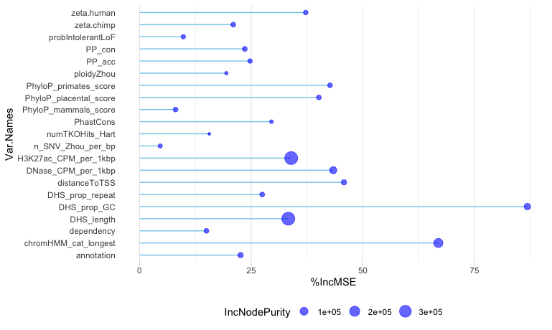
pVal Forest –p-value of change in log-fold expression as response vector
Excluding phyloP scores
Including phyloP scores

Slide 5
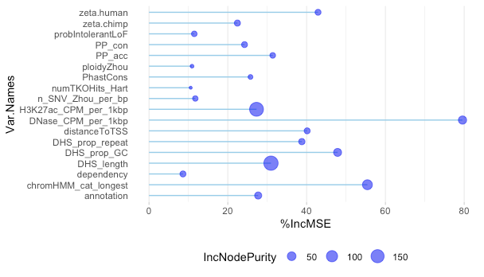
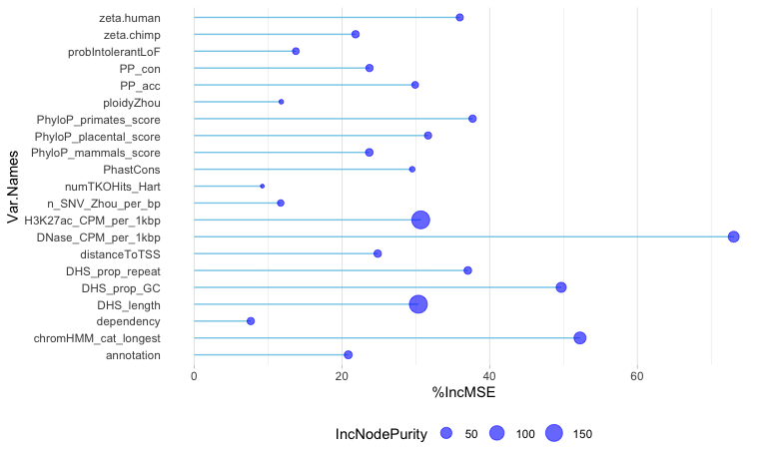
SignalVal Forest - continuous measurement of overall (usually, average) enrichment for the region
Excluding phyloP scores
Including phyloP scores

Slide 6
Next, adding one type of PhyloP at a time, starting with 242-way mammalian

Slide 7
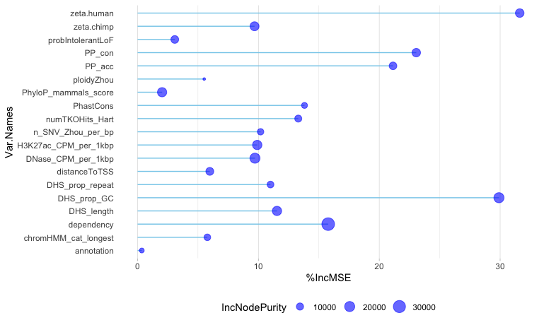
CERES Forest - wgCERES_score_nosig as the response vector
Excluding phyloP scores
Including 242-mammalian phyloP scores

Slide 8
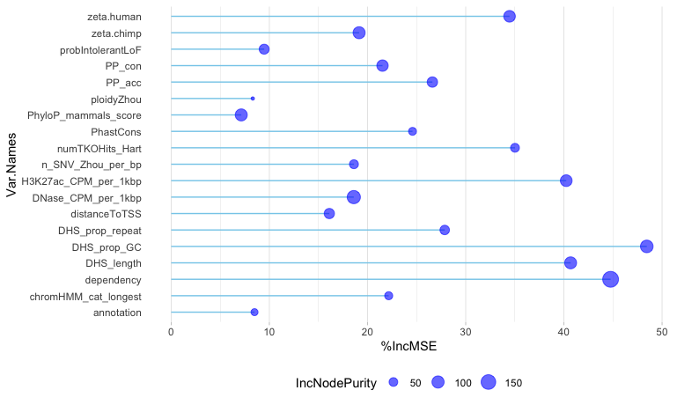
dhsWGsig Forest - dhs_0_1_wg (0,1: was DHS (all gRNAs grouped) significant across all DHSs?) as response vectors
Excluding phyloP scores
Including 242-mammalian phyloP scores

Slide 9
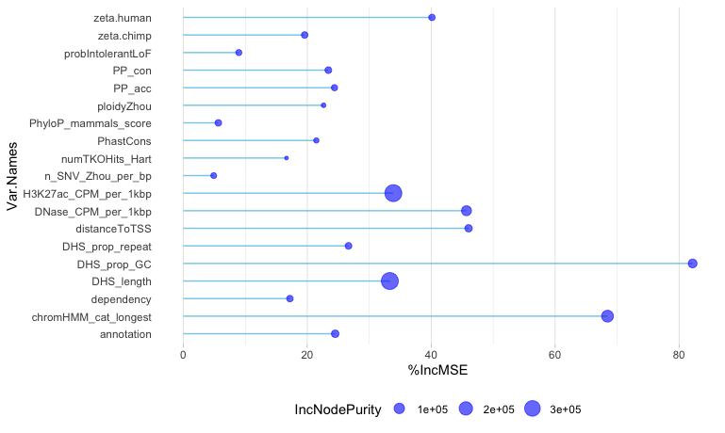
pVal Forest –p-value of change in log-fold expression as response vector
Excluding phyloP scores
Including 242-mammalian phyloP scores

Slide 10
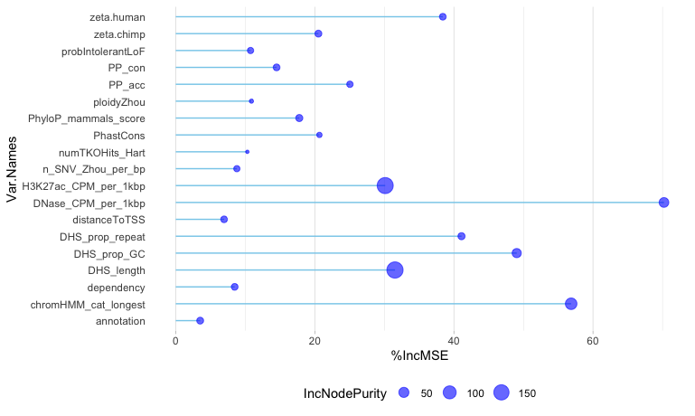
SignalVal Forest - continuous measurement of overall (usually, average) enrichment for the region
Excluding phyloP scores
Including 242-mammalian phyloP scores

Slide 11
46-way primate

Slide 12
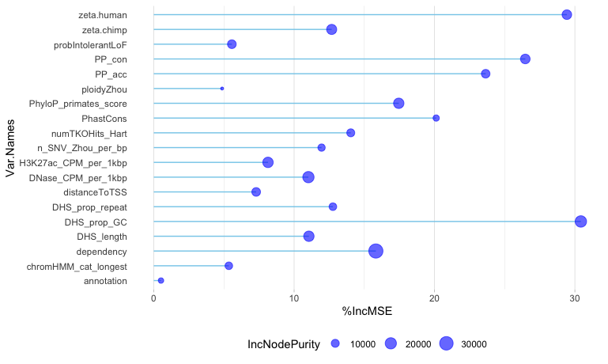
CERES Forest - wgCERES_score_nosig as the response vector
Excluding phyloP scores
Including 46-way primate phyloP scores

Slide 13
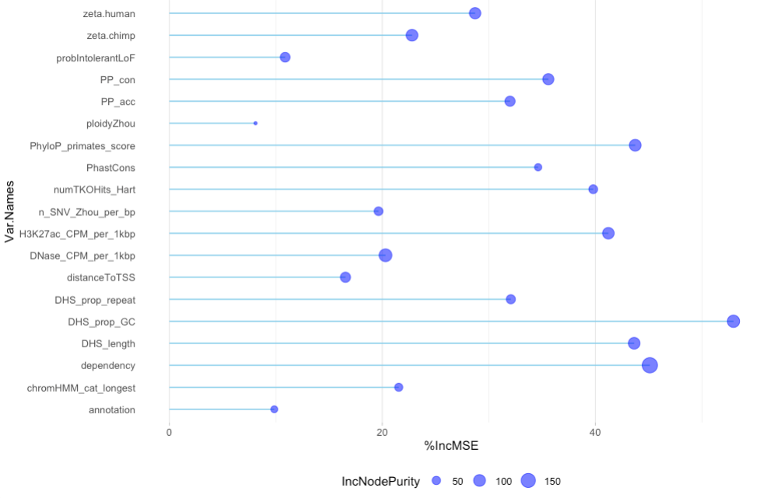
dhsWGsig Forest - dhs_0_1_wg (0,1: was DHS (all gRNAs grouped) significant across all DHSs?) as response vectors
Excluding phyloP scores
Including 46-way primate phyloP scores

Slide 14
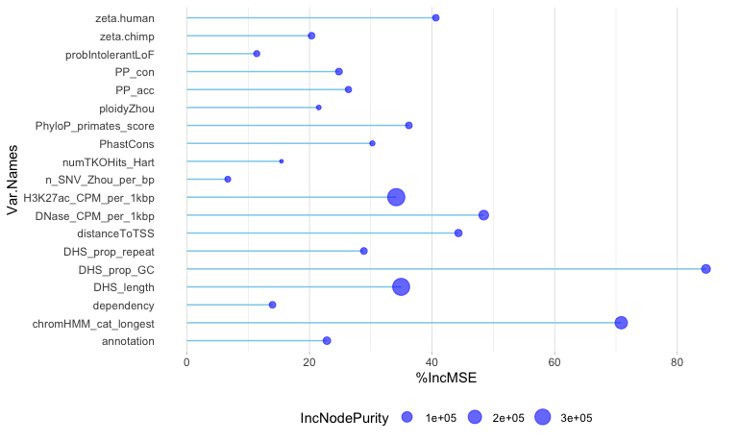
pVal Forest –p-value of change in log-fold expression as response vector
Excluding phyloP scores
Including 46-way primate phyloP scores

Slide 15
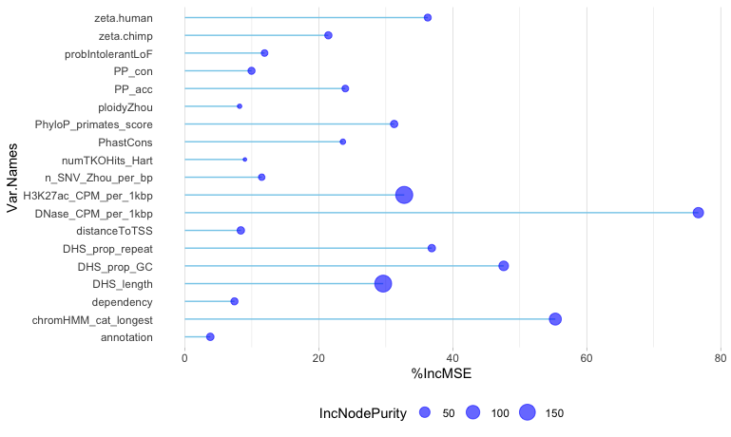
SignalVal Forest - continuous measurement of overall (usually, average) enrichment for the region
Excluding phyloP scores
Including 46-way primate phyloP scores

Slide 16
46-way placental

Slide 17
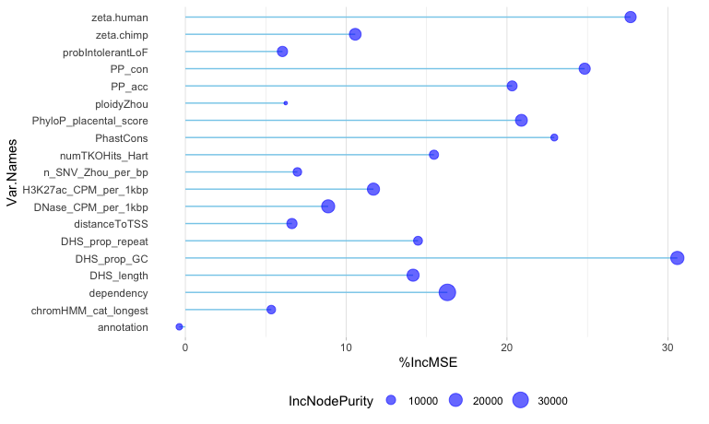
CERES Forest - wgCERES_score_nosig as the response vector
Excluding phyloP scores
Including 46-way placental phyloP scores

Slide 18
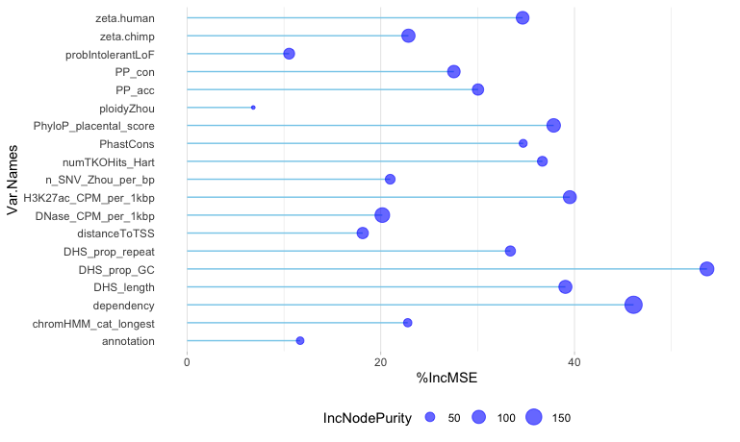
dhsWGsig Forest - dhs_0_1_wg (0,1: was DHS (all gRNAs grouped) significant across all DHSs?) as response vectors
Excluding phyloP scores
Including 46-way placental phyloP scores

Slide 19
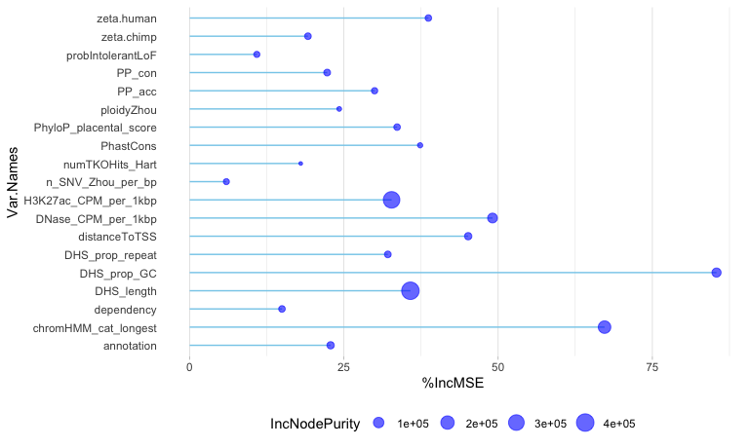
pVal Forest –p-value of change in log-fold expression as response vector
Excluding phyloP scores
Including 46-way placental phyloP scores

Slide 20
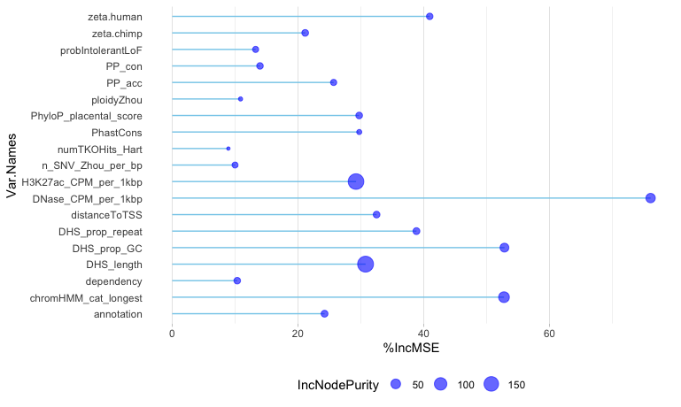
SignalVal Forest - continuous measurement of overall (usually, average) enrichment for the region
Excluding phyloP scores
Including 46-way placental phyloP scores

Slide 21
Now, deleting the “most important” predictors, i.e. DHS_prop_GC and zeta.human

Slide 22
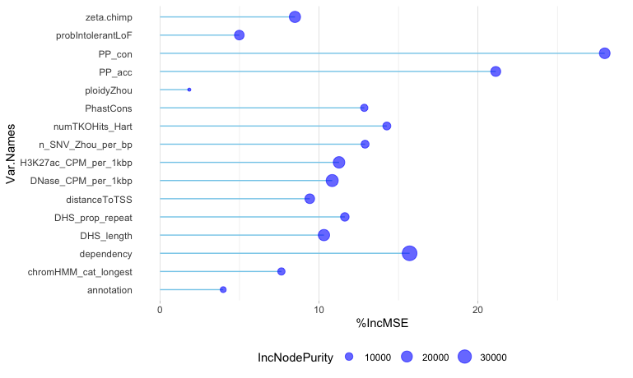
CERES Forest - wgCERES_score_nosig as the response vector
Original
DHS_prop_GC and zeta.human removed

Slide 23
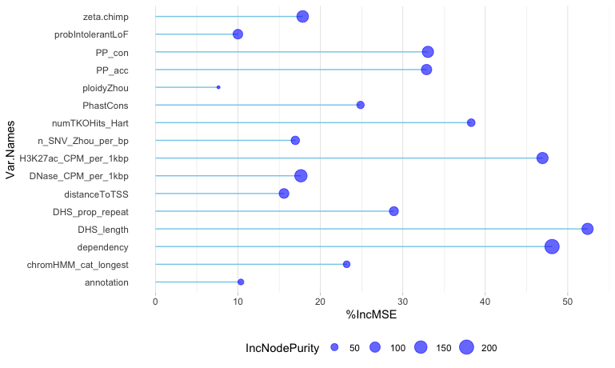
dhsWGsig Forest - dhs_0_1_wg (0,1: was DHS (all gRNAs grouped) significant across all DHSs?) as response vectors
Excluding phyloP scores
DHS_prop_GC and zeta.human removed

Slide 24
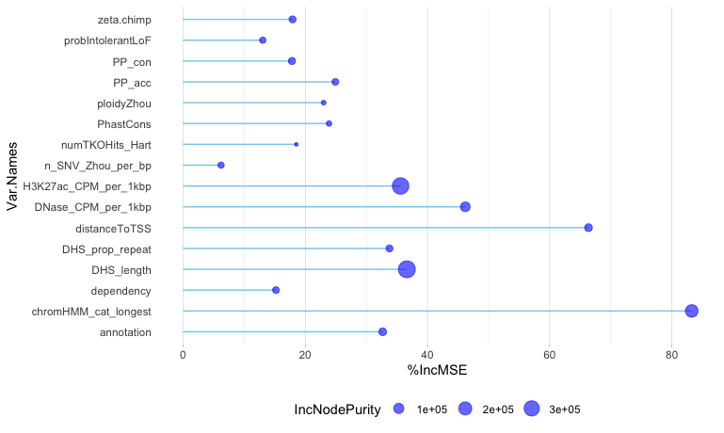
pVal Forest –p-value of change in log-fold expression as response vector
Excluding phyloP scores
DHS_prop_GC and zeta.human removed

Slide 25
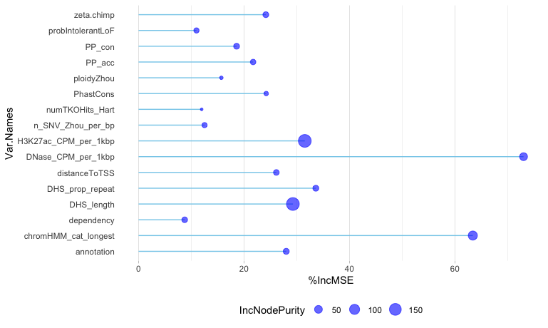
SignalVal Forest - continuous measurement of overall (usually, average) enrichment for the region
Excluding phyloP scores
DHS_prop_GC and zeta.human removed

Slide 26
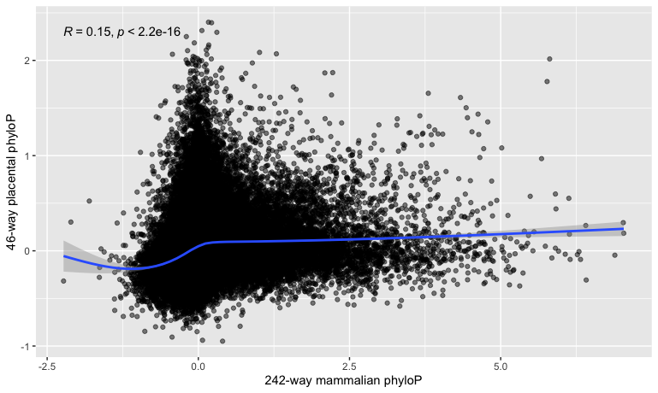
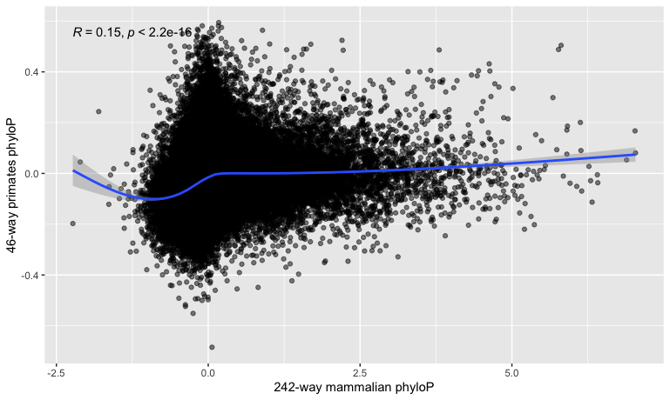
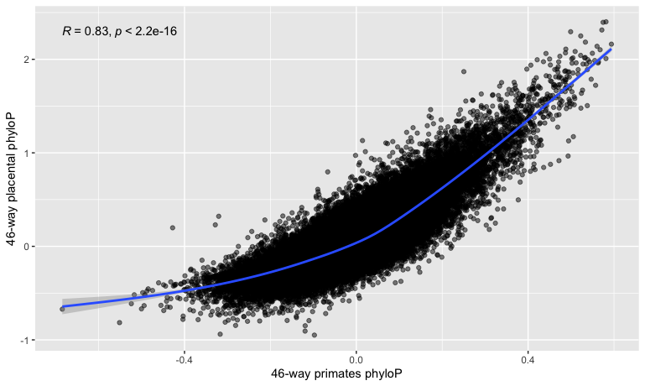
PhyloP comparison scatterplots
Notes:
Color these by chromHMM_cat_longest, see distribution of core promoters and distal enhancers…does the number of core promoters a gene has correlation to essentiality, as well as enhancers

Slide 27
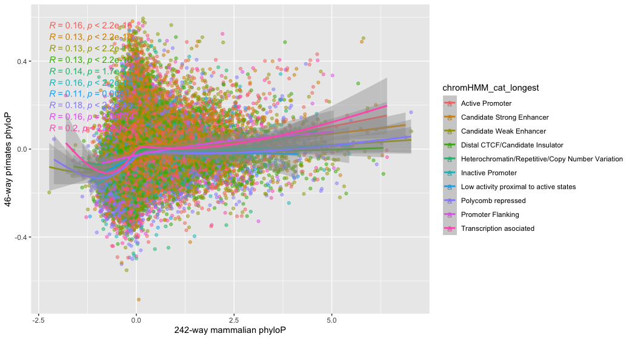
PhyloP comparison scatterplots: chromHMM_cat_longest
Notes:
Color these by chromHMM_cat_longest, see distribution of core promoters and distal enhancers…does the number of core promoters a gene has correlation to essentiality, as well as enhancers

Slide 28
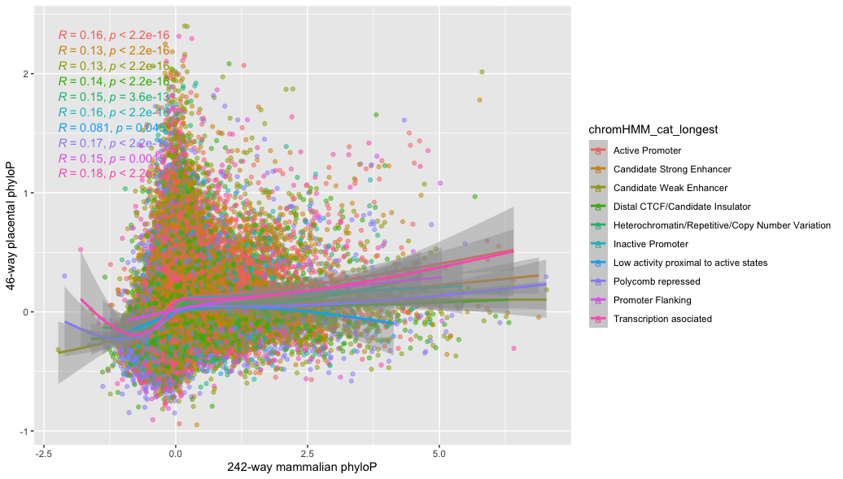
PhyloP comparison scatterplots: chromHMM_cat_longest
Notes:
Color these by chromHMM_cat_longest, see distribution of core promoters and distal enhancers…does the number of core promoters a gene has correlation to essentiality, as well as enhancers
What does trans assoc mean?
Includes: Active TSS, Flanking Active TSS, Transcription at gene 5’ and 3’, Strong Transcription, Weak transcription…unfortunately not explicitly documented, based on my own conjecture of the original chromHMM catgories

Slide 29
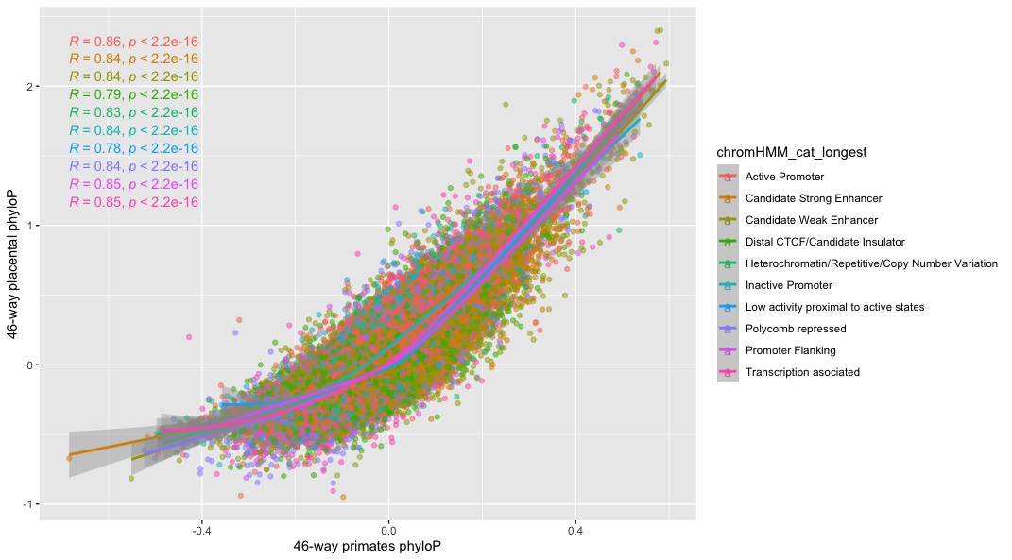
PhyloP comparison scatterplots: chromHMM_cat_longest
Notes:
Color these by chromHMM_cat_longest, see distribution of core promoters and distal enhancers…does the number of core promoters a gene has correlation to essentiality, as well as enhancers
Less noise here, intuition is the deeper you go the less information you have (opposite of what you would expect)…these depths are concordant meaning: interchangeable
In a coding sequence, intuition would hold that more conserved == more functional
Can we attach an interpretation to the CERES result…GC content, motif-mapping with HOMER..deep evolutionary conservation is not helpful, medium is, but what about GC content, motif enrichment
GC content is less likely to melt…separate core promotors…core promotors are AT-rich…to regulate DNA no melting required…pull OCRs by chromHMM and just compute GC on whole thing, compare…concatenate and character count (or just use word count –c from terminal for those, count tables, aggregated A’s and T’s, and G and C’s) is what we’re seeing here
Hyp1: These regions have high GC content because messing with the core promoters = no transcription, but enhancers are redundant and can compensate…less motif and more base composition perhaps?
Motif enrichment: we know transcription factors thanks to RNA-seq, can we sus out master trans factors for each cell type, motif for K562 (liver-derived), look for it among the 4-5 hepatic master transcription factosr: Hyp 2: their motifs are skewed GC/AT rich

Slide 30
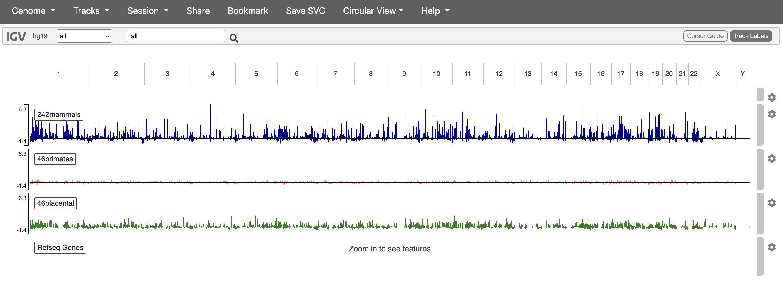
IGV view of phyloP scores vs. genomic location
Notes:
These appear opposite of the intuition…
Measure of disparity causes this
Whether core promoters and distal enhancers show similar measures of
Alejo gives you a list for the OCRs, distal enhancer core promoter chromHMM variable
Take top/bottom 10%/quintile phyloP , look at the properties of these
Why do the conservation scores matter so little to the RF???
RF is robust to noise(?)

Slide 31
chromHMM of top/bottom 242 mammalian phyloP scores
chromHMM category | Top 10% | Bottom 10% | Top 25% | Bottom 25%
Active Promoter | 0.206 | 0.121 | 0.211 | 0.143
Candidate Strong Enhancer | 0.165 | 0.115 | 0.181 | 0.136
Candidate Weak Enhancer | 0.202 | 0.232 | 0.198 | 0.222
Distal CTCF/Candidate Insulator | 0.171 | 0.170 | 0.178 | 0.176
Heterochromatin/Repetitive/Copy Number Variation | 0.029 | 0.037 | 0.026 | 0.035
Inactive Promoter | 0.054 | 0.034 | 0.052 | 0.041
Low activity proximal to active states | 0.098 | 0.008 | 0.008 | 0.009
Polycomb repressed | 0.098 | 0.192 | 0.090 | 0.578
Promoter flanking | 0.005 | 0.006 | 0.005 | 0.006
Transcription associated | 0.062 | 0.085 | 0.051 | 0.075
Top 10%
Notes:
Next top/bottom in terms proliferation
Think about other metrics to compare the DHSs…if this experiment was repeated in another cell type, good investigation of that, look at proximity to other genes
Is there a column for how much expression for the nearby gene changes for that DHS?
CERES motivation was CRISPR that knocked out protein coding, list of essential genes…now same question but for regulatory elements…are there reg. elements that have effect on proliferation that are independent of protein coding…redundancy may have an effect on it

Slide 32
Outcome measures of top/bottom 242 mammalian phyloP scores
Outcome | Top 10% | Bottom 10% | Top 25% | Bottom 25%
wgCERES_score_nosig | -0.01252202 | 0.05540752 | 0.007660683 | 0.06887374
Dhs_0_1_wg | 0.02411168 | 0.01865482 | 0.0271066 | 0.02050761
pValue (-log10) | 5.275745 | 1.827 | 3.905 | 4.373

Slide 33
chromHMM of top/bottom 46 primate phyloP scores
chromHMM category | Top 10% | Bottom 10% | Top 25% | Bottom 25%
Active Promoter | 0.180 | 0.182 | 0.184 | 0.194
Candidate Strong Enhancer | 0.213 | 0.071 | 0.210 | 0.096
Candidate Weak Enhancer | 0.231 | 0.204 | 0.218 | 0.201
Distal CTCF/Candidate Insulator | 0.127 | 0.152 | 0.160 | 0.173
Heterochromatin/Repetitive/Copy Number Variation | 0.031 | 0.030 | 0.029 | 0.030
Inactive Promoter | 0.036 | 0.055 | 0.039 | 0.056
Low activity proximal to active states | 0.007 | 0.010 | 0.007 | 0.009
Polycomb repressed | 0.093 | 0.200 | 0.084 | 0.165
Promoter flanking | 0.008 | 0.008 | 0.006 | 0.007
Transcription associated | 0.0735 | 0.088 | 0.062 | 0.069
Notes:
What does “strong/weak” indicate …enhancer transcription is the most reliable, otherwise its “permissive” rather than deterministic state

Slide 34
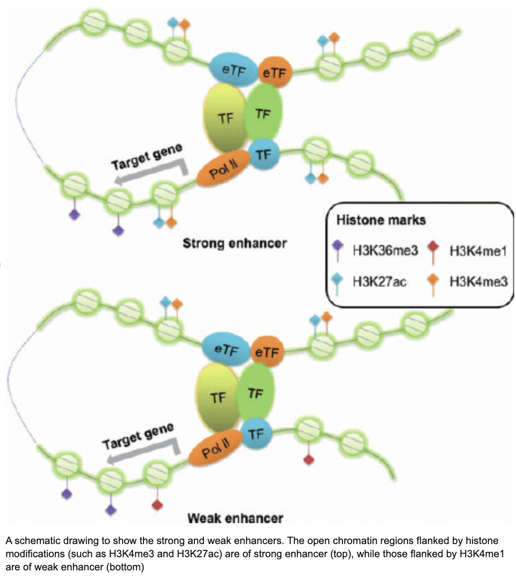

Slide 35
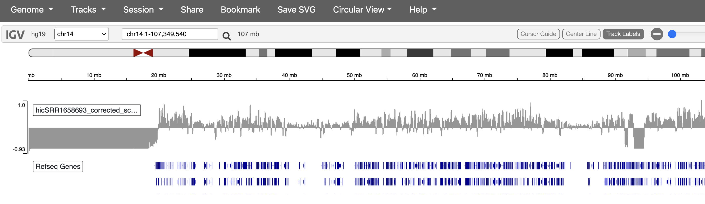
HiC results

Slide 36
Outcome measures of top/bottom 46 primate phyloP scores
Outcome | Top 10% | Bottom 10% | Top 25% | Bottom 25%
wgCERES_score_nosig | 0.1830151 | -0.06633533 | 0.1242989 | -0.06382778
Dhs_0_1_wg | 0.02327028 | 0.0261324 | 0.02419355 | 0.02723019
pValue | 3.944105 | 4.881663 | 4.512804 | 5.202045

Slide 37
chromHMM of top/bottom 46 placental phyloP scores
chromHMM category | Top 10% | Bottom 10% | Top 25% | Bottom 25%
Active Promoter | 0.249 | 0.140 | 0.260 | 0.154
Candidate Strong Enhancer | 0.162 | 0.077 | 0.169 | 0.106
Candidate Weak Enhancer | 0.197 | 0.203 | 0.191 | 0.207
Distal CTCF/Candidate Insulator | 0.111 | 0.162 | 0.142 | 0.178
Heterochromatin/Repetitive/Copy Number Variation | 0.029 | 0.034 | 0.026 | 0.036
Inactive Promoter | 0.060 | 0.041 | 0.062 | 0.046
Low activity proximal to active states | 0.006 | 0.009 | 0.005 | 0.009
Polycomb repressed | 0.096 | 0.222 | 0.081 | 0.178
Promoter flanking | 0.007 | 0.007 | 0.005 | 0.007
Transcription associated | 0.083 | 0.105 | 0.060 | 0.080

Slide 38
Outcome measures of top/bottom 46 placental phyloP scores
Outcome | Top 10% | Bottom 10% | Top 25% | Bottom 25%
wgCERES_score_nosig | 0.04365849 | -0.01977992 | -0.01168551 | -0.02178625
Dhs_0_1_wg | 0.03123444 | 0.0261324 | 0.02961967 | 0.02309837
pValue | 5.030772 | 4.265472 | 5.617906 | 4.665448

Slide 39
chromHMM of top/bottom CERES scores
chromHMM category | Top 10% | Bottom 10% | Top 25% | Bottom 25%
Active Promoter | 0.143 | 0.340 | 0.145 | 0.255
Candidate Strong Enhancer | 0.209 | 0.125 | 0.197 | 0.143
Candidate Weak Enhancer | 0.209 | 0.168 | 0.211 | 0.192
Distal CTCF/Candidate Insulator | 0.212 | 0.131 | 0.210 | 0.154
Heterochromatin/Repetitive/Copy Number Variation | 0.034 | 0.023 | 0.033 | 0.025
Inactive Promoter | 0.035 | 0.049 | 0.039 | 0.053
Low activity proximal to active states | 0.007 | 0.007 | 0.007 | 0.007
Polycomb repressed | 0.095 | 0.100 | 0.100 | 0.109
Promoter flanking | 0.004 | 0.004 | 0.006 | 0.006
Transcription associated | 0.050 | 0.053 | 0.052 | 0.057
Top 10%
Notes:
Next top/bottom in terms proliferation
Think about other metrics to compare the DHSs…if this experiment was repeated in another cell type, good investigation of that, look at proximity to other genes
Is there a column for how much expression for the nearby gene changes for that DHS?
CERES motivation was CRISPR that knocked out protein coding, list of essential genes…now same question but for regulatory elements…are there reg. elements that have effect on proliferation that are independent of protein coding…redundancy may have an effect on it
Enhancer have higher CERES scores, maybe makes sense since they are primarily responsible for controlling expression

Slide 40
Is there a column for how much expression for the nearby gene changes for that DHS?
Sort of, probIntolerantLoF "Probability that the closest gene is intolerant to loss of function (from Exac, Lek et al. Nature 2016)” (also binary version called probIntolerantLoF_gt_0.9)
As a start, we can look at the DHS’s that shows up as TRUE for this variable
There is one variable that explicitely measures gene expression (medianRNAseqTPM), however it doesn’t appear to measure changes in expression due to knockout, it simply represents “Median TPM of the mean TPM of 4 ENCODE K562 RNA-seq experiments”

Slide 41
Is the probability that the closest gene is intolerant to loss of function is higher than 0.9?
chromHMM category | frequency | medianRNAseqTPM
Active Promoter | 0.198 | 84.5
Candidate Strong Enhancer | 0.191 | 44.2
Candidate Weak Enhancer | 0.196 | 33.4
Distal CTCF/Candidate Insulator | 0.168 | 30.4
Heterochromatin/Repetitive/Copy Number Variation | 0.029 | 65.7
Inactive Promoter | 0.041 | 24.6
Low activity proximal to active states | 0.006 | 66.5
Polycomb repressed | 0.099 | 17.7
Promoter flanking | 0.006 | 15.3
Transcription associated | 0.065 | 44.7

Slide 42
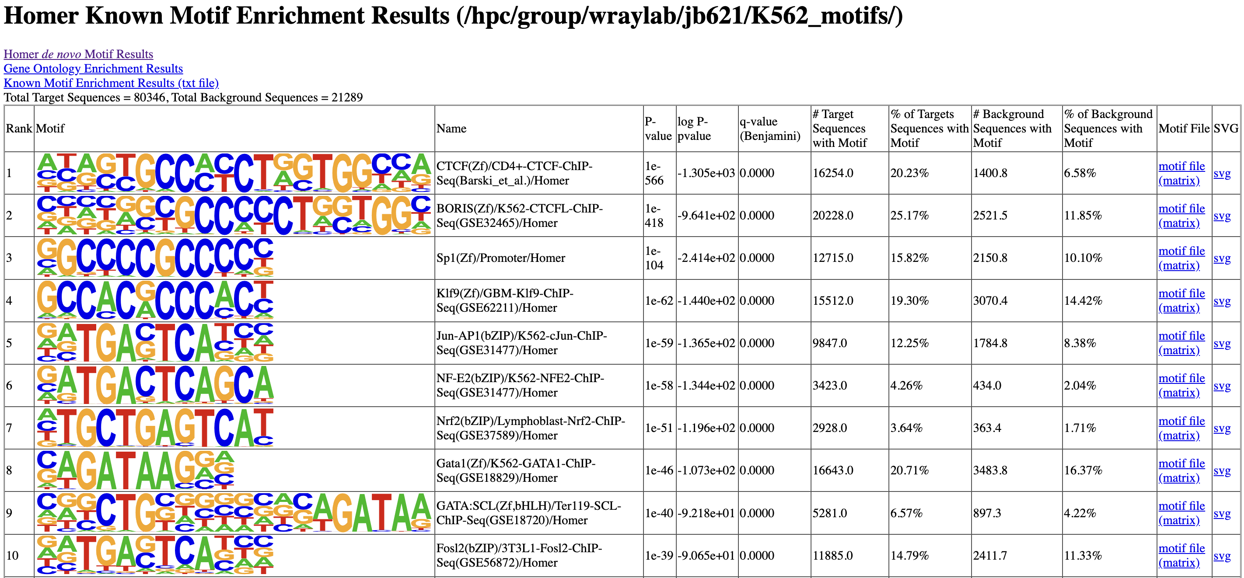
DHS sequence attributes – lncRNA Hg19 background
Aggregated chromHMM category | Average % GC | Average % AT
Promoter | 0.512 | 0.488
Enahncer | 0.596 | 0.404
Notes:
Compare CERES score between GC-rich motifs (for TFs) and just a random GCrich sequence (AND nonGCrich)
As background, pull DHS sites from different cell types (neuron, endo/ecto dermal cells for example) that Alejo could give you.
Jun and Fos – possibly a marker for more dynamic activity
Both enriched and changed on branch in correlated way
Sibbata et al (Greg Crawford, ATAC-seq comparative chromatin paper)

Slide 43
chromHMM of the DHS’s containing the enriched, known HOMER motifs
chromHMM category | Contains Rank2 motif ‘GCCCCCTGGTGG’ | Contains Rank6 motif 'TGACTCAGCA' | Contains Rank 8 motif 'AGATAAG'
Active Promoter | 25 (0.105) | 63 (0.128) | 770 (0.168)
Candidate Strong Enhancer | 7 (0.030) | 226 (0.458) | 1600 (0.348)
Candidate Weak Enhancer | 28 (0.118) | 137 (0.278) | 1287 (0.280)
Distal CTCF/Candidate Insulator | 127 (0.536) | 11 (0.022) | 313 (0.068)
Heterochromatin/Repetitive/Copy Number Variation | 16 (0.068) | 2 (0.004) | 123 (0.027)
Inactive Promoter | 19 (0.080) | 6 (0.012) | 120 (0.026)
Low activity proximal to active states | - | 2 (0.004) | 11 (0.002)
Polycomb repressed | 8 (0.034) | 31 (0.063) | 196 (0.43)
Promoter flanking | - | 3 (0.006) | 23 (0.005)
Transcription associated | 7 (0.030) | 12 (0.024) | 152 (0.033)
Notes:
Subsetting by the previous motifs, see whether that is well/not-well conserved (primate specifically)…problem is we don’t have
Alejo could give you OCRs that are open in other cell types, not unique to a particular cell type: http://genome.ucsc.edu/cgi-bin/hgTables?hgsid=1396517773_cxAsIILdDYP7AXC7WavnPJ0yKXrE&clade=mammal&org=Human&db=hg19&hgta_group=regulation&hgta_track=wgEncodeOpenChromDnase&hgta_table=wgEncodeOpenChromDnaseCerebellumocPk&hgta_regionType=genome&position=chrX%3A15%2C578%2C261-15%2C621%2C068&hgta_outputType=primaryTable&hgta_outFileName=phyloP_241mammalsv2
JASPER, what is Jas, Ap1 consensus, allow 1-2 mismatches search for that
Primate phyloP score correlation and presence/absence
Compare CERES score between GC-rich motifs (for TFs) and just a random GCrich sequence (AND nonGCrich)
As background, pull DHS sites from different cell types (neuron, endo/ecto dermal cells for example) that Alejo could give you.
Jun and Fos – possibly a marker for more dynamic activity
Both enriched and changed on branch in correlated way
Sibbata et al (Greg Crawford, ATAC-seq comparative chromatin paper)

Slide 44
Outcome measures of DHS’s containing the enriched HOMER motifs
Outcome | Contains Rank2 motif ‘GCCCCCTGGTGG’ | Contains Rank6 motif 'TGACTCAGCA' | Contains Rank 8 motif 'AGATAAG'
wgCERES_score_nosig | 0.09256427 | 0.2194022 | 0.169613
Dhs_0_1_wg | 0.02531646 | 0.02231237 | 0.023154526
pValue | 7.330591 | 4.854564 | 5.419765

Slide 45
chromHMM and CERES scores of the DHS’s containing the Jus and Fos HOMER motifs
chromHMM category | Jun-AP1 (-TGACTCAT) motif | Fos2 (GATGACTCA-) motif
Active Promoter | 246 (0.134) | 65 (0.103)
Candidate Strong Enhancer | 655 (0.356) | 245 (0.389)
Candidate Weak Enhancer | 523 (0.284) | 193 (0.306)
Distal CTCF/Candidate Insulator | 119 (0.065) | 28 (0.044)
Heterochromatin/Repetitive/Copy Number Variation | 51 (0.028) | 12 (0.019)
Inactive Promoter | 40 (0.022) | 13 (0.021)
Low activity proximal to active states | 13 (0.007) | 5 (0.008)
Polycomb repressed | 123 (0.067) | 47 (0.075)
Promoter flanking | 10 (0.005) | 1 (0.002)
Transcription associated | 61 (0.033) | 21 (0.033)
CERES_wg_nosig | 0.2077 | 0.1887
46-way primate PhyloP | -0.0028 | -0.0017
Notes:
Subsetting by the previous motifs, see whether that is well/not-well conserved (primate specifically)…problem is we don’t have
Alejo could give you OCRs that are open in other cell types, not unique to a particular cell type: http://genome.ucsc.edu/cgi-bin/hgTables?hgsid=1396517773_cxAsIILdDYP7AXC7WavnPJ0yKXrE&clade=mammal&org=Human&db=hg19&hgta_group=regulation&hgta_track=wgEncodeOpenChromDnase&hgta_table=wgEncodeOpenChromDnaseCerebellumocPk&hgta_regionType=genome&position=chrX%3A15%2C578%2C261-15%2C621%2C068&hgta_outputType=primaryTable&hgta_outFileName=phyloP_241mammalsv2
JASPER, what is Jas, Ap1 consensus, allow 1-2 mismatches search for that
Primate phyloP score correlation and presence/absence of motif
Compare CERES score between GC-rich motifs (for TFs) and just a random GCrich sequence (AND nonGCrich)
As background, pull DHS sites from different cell types (neuron, endo/ecto dermal cells for example) that Alejo could give you.
Jun and Fos – possibly a marker for more dynamic activity
Both enriched and changed on branch in correlated way
Sibbata et al (Greg Crawford, ATAC-seq comparative chromatin paper)

Slide 46
chromHMM of the highly/poorly conserved (according to 46-way primate) DHS’s
chromHMM category | Highly conserved (PhyloP > 2) | Poorly conserved (PhyloP < 2)
Active Promoter | 5516 (0.182) | 9273 (0.185)
Candidate Strong Enhancer | 6341 (0.209) | 7288 (0.146)
Candidate Weak Enhancer | 6536 (0.215) | 9994 (0.200)
Distal CTCF/Candidate Insulator | 5280 (0.174) | 9674 (0.193)
Heterochromatin/Repetitive/Copy Number Variation | 876 (0.029) | 1514 (0.030)
Inactive Promoter | 1216 (0.040) | 2579 (0.052)
Low activity proximal to active states | 207 (0.007) | 421 (0.008)
Polycomb repressed | 2499 (0.082) | 6216 (0.124)
Promoter flanking | 157 (0.005) | 302 (0.006)
Transcription associated | 1714 (0.056) | 2750 (0.055)
CERES_wg_nosig | 0.1195 | -0.0178
Notes:
Subsetting by the previous motifs, see whether that is well/not-well conserved (primate specifically)…problem is we don’t have
Alejo could give you OCRs that are open in other cell types, not unique to a particular cell type: http://genome.ucsc.edu/cgi-bin/hgTables?hgsid=1396517773_cxAsIILdDYP7AXC7WavnPJ0yKXrE&clade=mammal&org=Human&db=hg19&hgta_group=regulation&hgta_track=wgEncodeOpenChromDnase&hgta_table=wgEncodeOpenChromDnaseCerebellumocPk&hgta_regionType=genome&position=chrX%3A15%2C578%2C261-15%2C621%2C068&hgta_outputType=primaryTable&hgta_outFileName=phyloP_241mammalsv2
JASPER, what is Jas, Ap1 consensus, allow 1-2 mismatches search for that
Primate phyloP score correlation and presence/absence of motif
Compare CERES score between GC-rich motifs (for TFs) and just a random GCrich sequence (AND nonGCrich)
As background, pull DHS sites from different cell types (neuron, endo/ecto dermal cells for example) that Alejo could give you.
Jun and Fos – possibly a marker for more dynamic activity
Both enriched and changed on branch in correlated way
Sibbata et al (Greg Crawford, ATAC-seq comparative chromatin paper)

Slide 47
Compare CERES score between GC-rich motifs specific to TFs and random GC-rich sequence
The Sp1(Zf)/Promoter has the sequence “GGCCCCGCCCCC”, comparing between a randomly shuffled 12 bp sequence of CG’s, as well as GC-rich and non-GC rich DHS sequences
Motif | Mean CERES score (n)
Sp1 (GGCCCCGCCCCC) | -0.542 (n = 557)
Random GC 12mer (CGGGCCGGCGCC) | -0.606 (n = 33)
GC-rich (>70% of sequence) | -0.460 (n = 2170)
Non-GC-rich (<50% of sequence) | 0.381 (n = 28846)

Slide 48
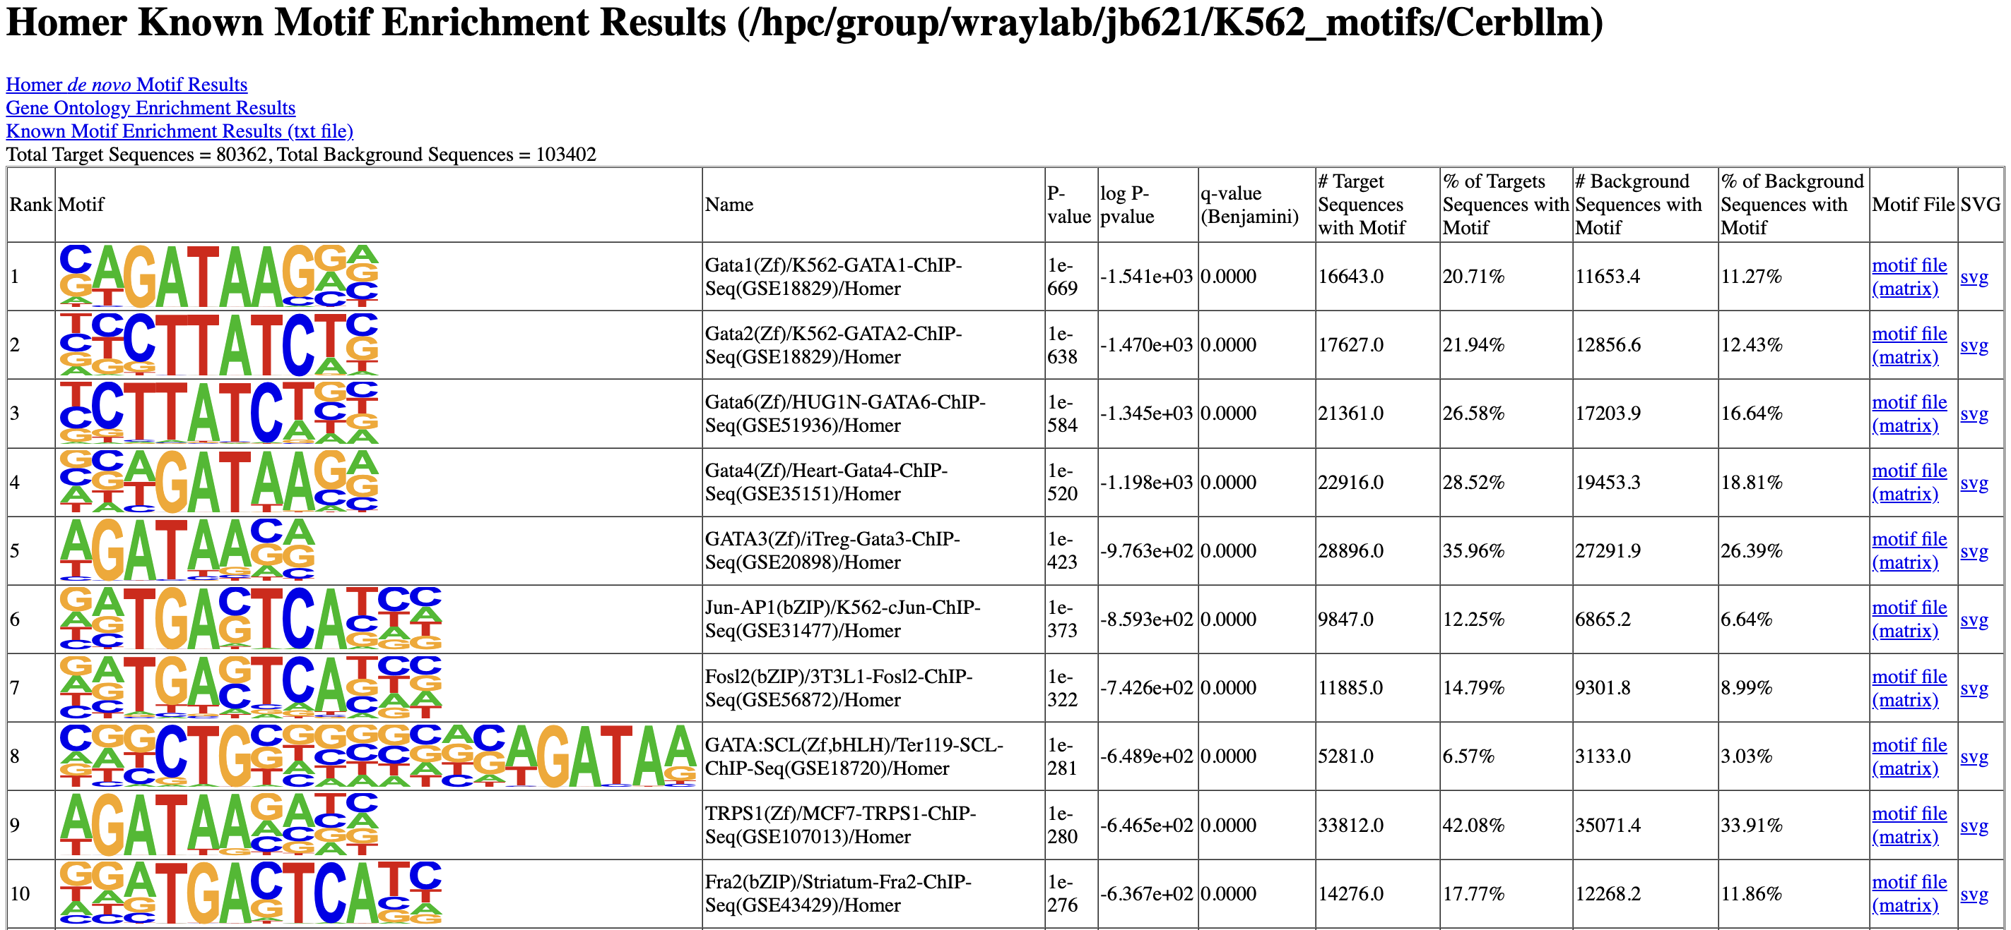
DHS sequence attributes – Crbllm DHS’s background
Aggregated chromHMM category | Average % GC | Average % AT
Promoter | 0.512 | 0.488
Enahncer | 0.596 | 0.404

Slide 49
HiC Results

Slide 50
HiC Results

